Slide 1

What is RefSeqGene?

Slide 2
Introductions
Donna Maglott, Ph.D.
Worked on NCBI RefSeq since 1998
Worked on NCBI Gene (via LocusLink) and RefSeq since 1998
Worked on RefSeqGene since 2007 (thank you Dr. Gulley)
Increasing emphasis on resources for medical genetics (including PheGenI, ClinVar, and the Genetic Testing Registry, GTR)
RefSeqGene
http://www.ncbi.nlm.nih.gov/refseq/rsg
http://www.ncbi.nlm.nih.gov/nuccore/?term=refseqgene

Slide 3
Outline
What is RefSeqGene?
How can I find a RefSeqGene sequence of interest?
How does a RefSeqGene record help me?
What tools are available?
Using RefSeqGene in a sample workflow

Slide 4
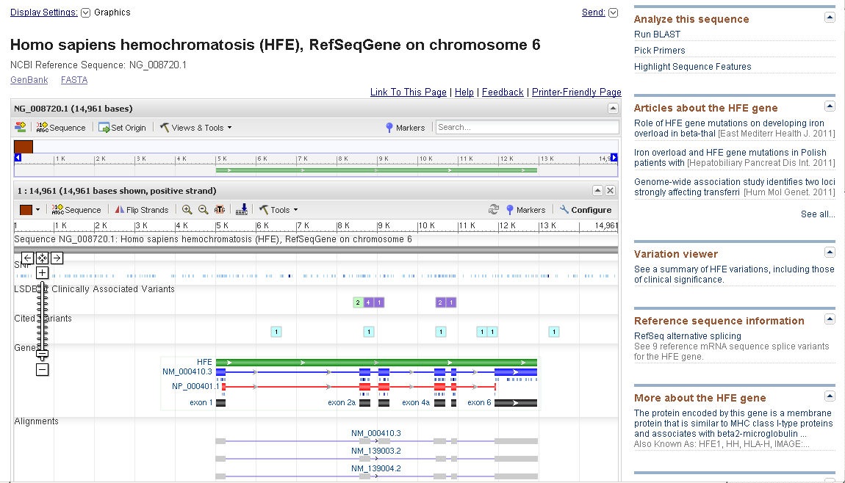
What is RefSeqGene?
Gene-specific genomic sequence
Starting about 5 kb upstream and ending about 2 kb downstream of a gene
Coordinates do not change when the genome is re-assembled
Snippet of a display of http://www.ncbi.nlm.nih.gov/nuccore/NG_008720.1?report=graph

Slide 5
What is RefSeqGene?: A versioned sequence
Each sequence is assigned an accession (NG_008720) and a version (1) . If the sequence changes in any way, the version is incremented (2, 3, …), If text changes (e.g. a citation is added), the version does NOT change. Thus, to report a sequence explicitly, the accession AND version must be provided.
NG_008720.1

Slide 6
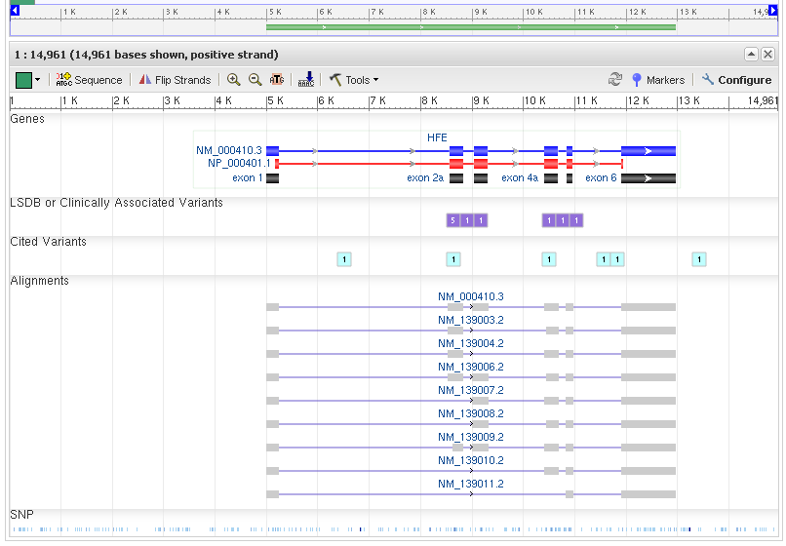
What is RefSeqGene? Both sequence and annotation
Locations of
the gene
the exons
the coding region
exons represented in other RefSeqs
Variation:
All
Subset from clinical sources
Subset associated with publication

Slide 7
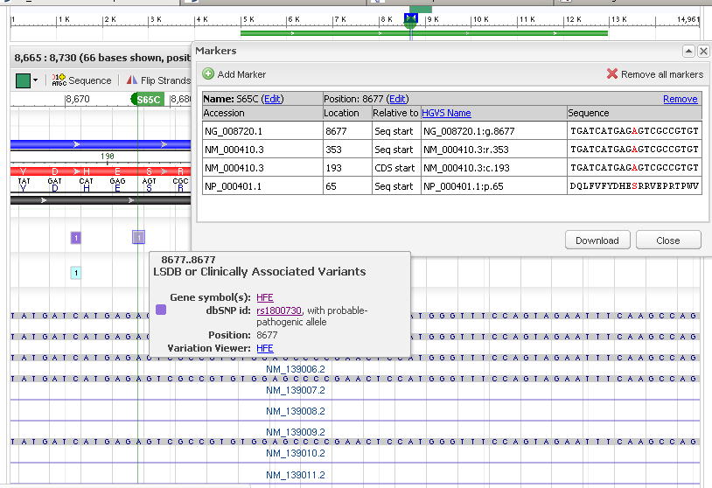
Zooming in to view the sequence and annotation…
At a location, set a marker or mouse over a box to see more details such as HGVS expressions, identifiers in dbSNP, links to more tools

Slide 8
What is RefSeqGene?
Collection of curated gene-specific genomic sequences requested from, or with feedback, from Locus-Specific Databases (LSDB)
May differ from current reference genome to represent the allele accepted as the reference
May include sequence not currently represented in the genome
May retain multiple differences from the genome if an accepted standard
Partner in Locus Reference Genome (LRG) collaboration
Exact nucleotide-nucleotide match between a version of a RefSeqGene and an LRG accession
Exact nucleotide-nucleotide match between RefSeq cDNAs (NM_) and transcripts (t) annotated on the LRG
Exact amino acid match between RefSeq proteins (NP_) and proteins (p) annotated on the LRG
http://lrg-sequence.org

Slide 9
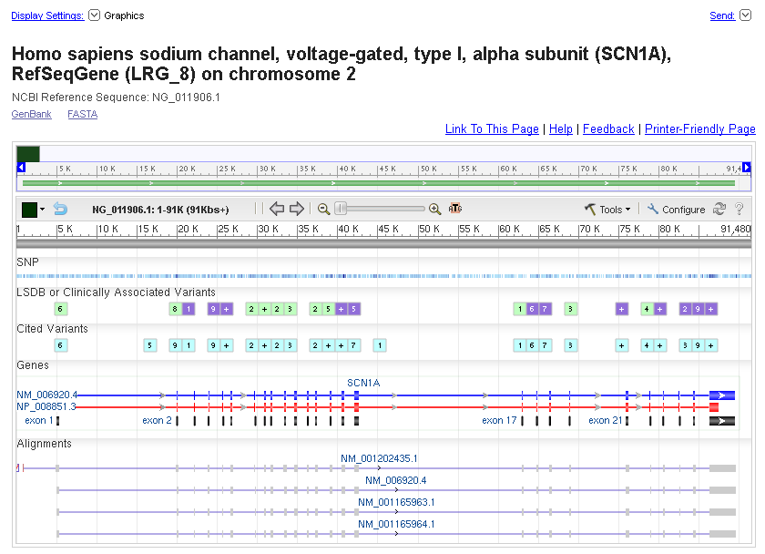
A RefSeqGene that is also an LRG
NG_0011906.1 | LRG_8
NM_006920.4 | t1
NP_008851.3 | p1

Slide 10
Outline
What is RefSeqGene?
How can I find a RefSeqGene sequence of interest?
How does a RefSeqGene record help me?
What tools are available?
Using RefSeqGene in a sample workflow

Slide 11

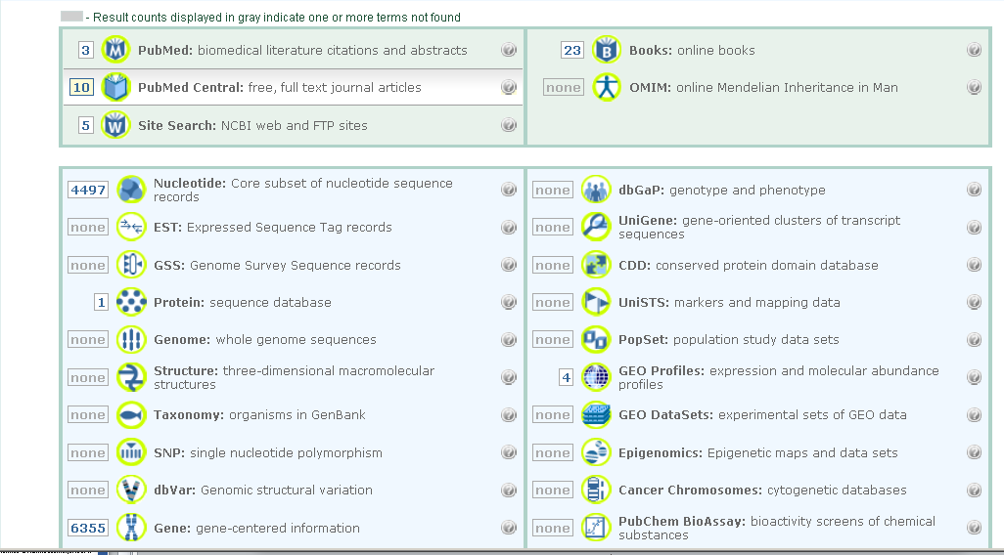
Query NCBI refseqgene (no spaces)

Slide 12
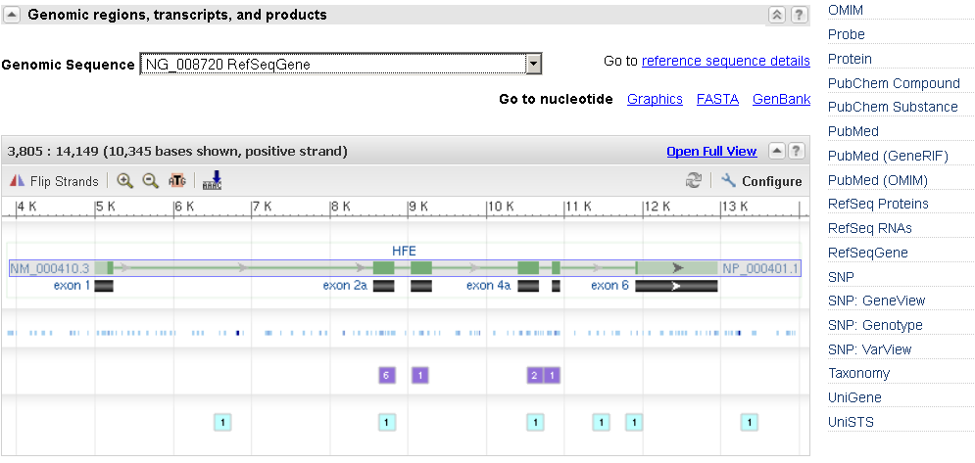
Query Gene or Nucleotide by refseqgene AND genesymbol (e.g. HFE AND refseqgene)
In Gene (only a subsection displayed here)
In Genomic regions, transcripts, and products, select RefSeqGene
In the Links section, follow the link RefSeqGene to Nucleotide

Slide 13
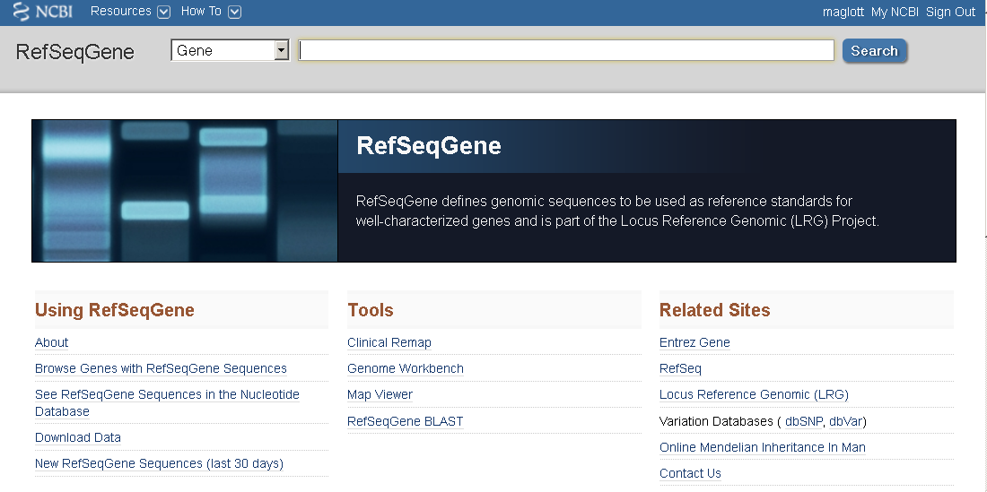
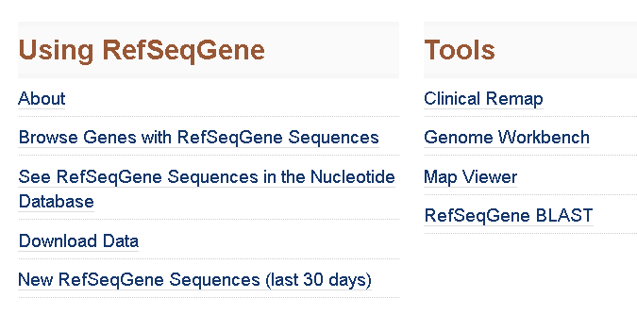
From the RefSeqGene site: http://www.ncbi.nlm.nih.gov/refseq/rsg

Slide 14
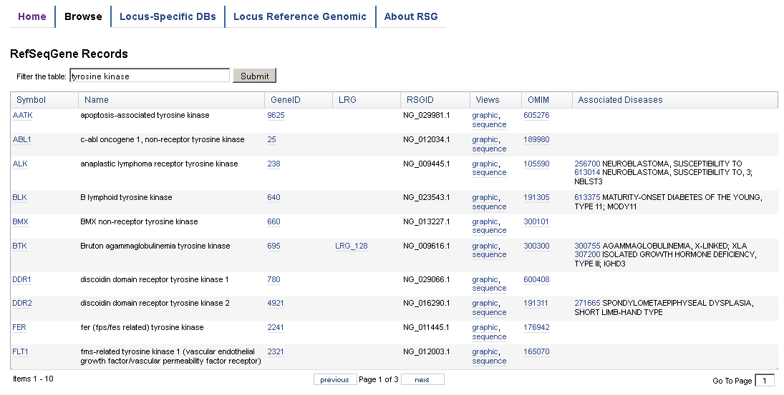
RefSeqGene: Browse, with an option to apply filters
Displays gene symbol, full name, GeneID, LRG accession, RefSeqGene accession and version, MIM numbers, and associated disorders, with links

Slide 15
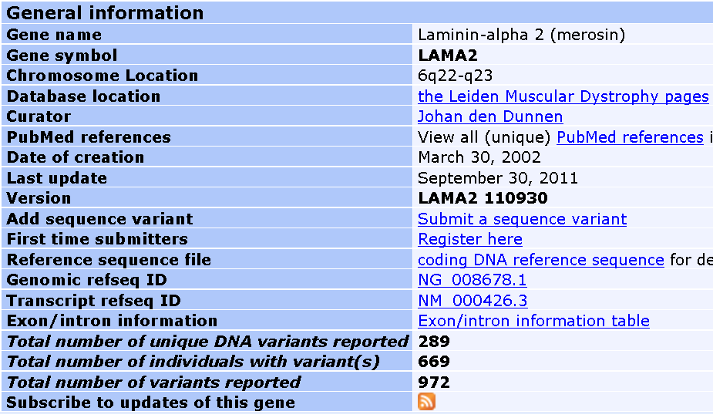
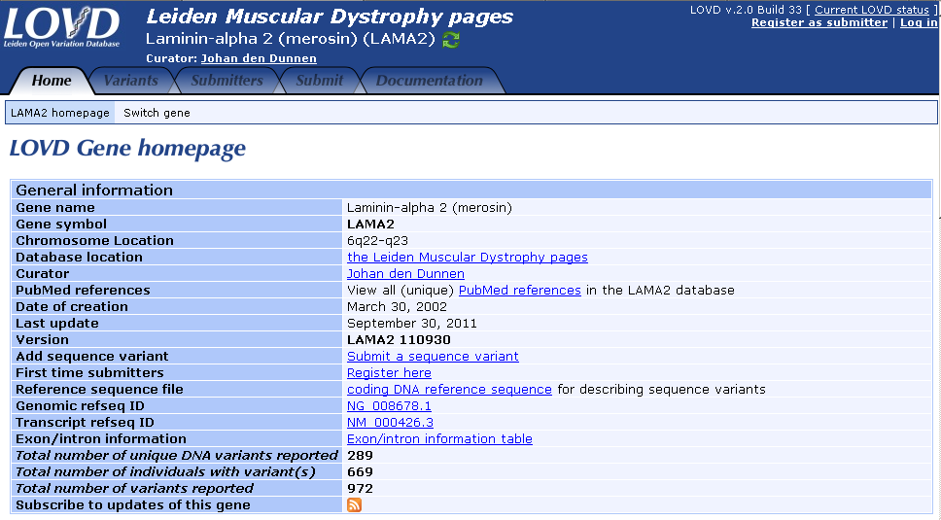
RefSeqGenes as standards in LSDB

Slide 16
Outline
What is RefSeqGene?
How can I find a RefSeqGene sequence of interest?
How does a RefSeqGene record help me?
What tools are available?
Using RefSeqGene in a sample workflow

Slide 17
How does a RefSeqGene record help me?
Provides standard genomic sequence for reporting variation
Because genomic, reporting of location is not affected by splice variants or identification of the start codon
Reporting of location is independent of re-assembling of the human genome
Used within NCBI to anchor information about common and rare variation
Provides links to records in LSDB
Provides links to the literature via GeneReviews, OMIM, PubMed
Provides links to variation currently being tested
Reported in tools, such as BLAST, Clinical Remap, and Variation Reporter

Slide 18
How does a RefSeqGene record help me?
May be referenced in practice guidelines
Excerpt from recent correspondence requesting an LRG accession based on a RefSeqGene record:
…We are now revising the best practice guidelines, and would ideally like to be able to reference an LRG for the … locus…

Slide 19


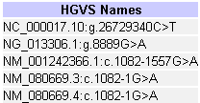

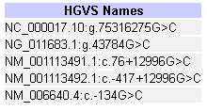

HGVS expressions using RefSeqGene
(cut from variation pages in dbSNP)
Within a coding region
CFTR
Intronic
SLC46A1
Flanking and intronic
SEPT9

Slide 20
Outline
What is RefSeqGene?
How can I find a RefSeqGene sequence of interest?
How does a RefSeqGene record help me?
What tools are available?
Using RefSeqGene in a sample workflow

Slide 21
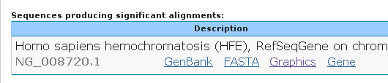
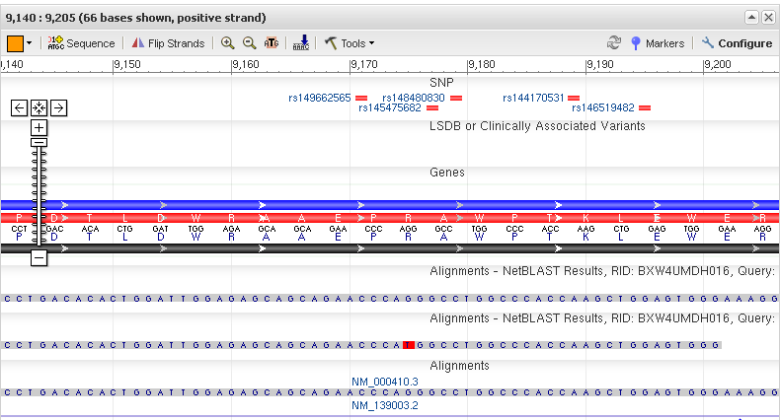
RefSeqGene BLAST Use BLAST to find the RefSeqGene matching your query and determine if any differences correspond to known variation
Submit one or more sequences
Display results on the graphical display
Compare any differences in your sequences to annotated variation

Slide 22
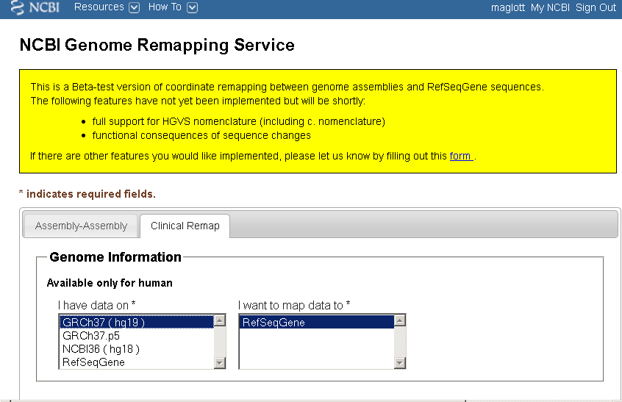
Tools: Clinical Remap
www.ncbi.nlm.nih.gov/genome/tools/remap
Interconverts chromosome and RefSeqGene coordinates

Slide 23
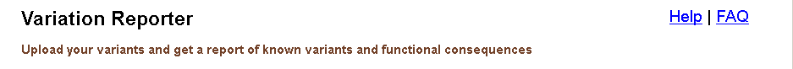
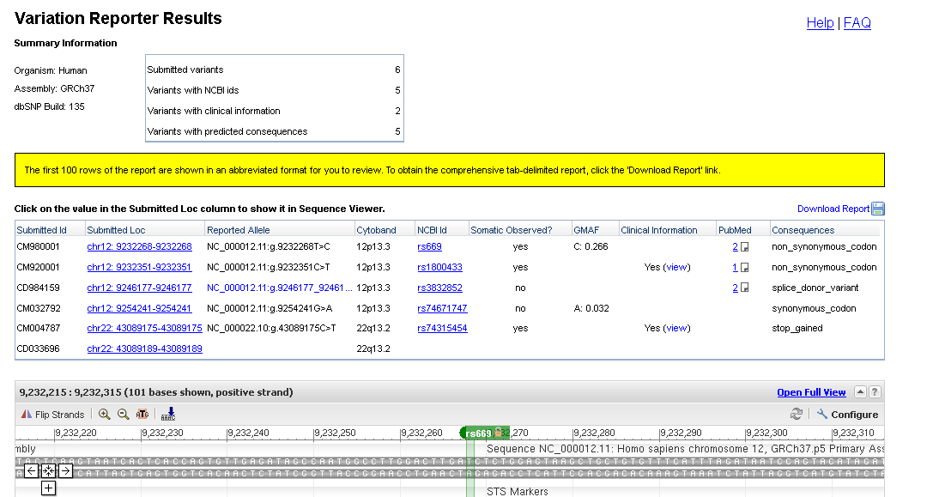
http://www.ncbi.nlm.nih.gov/variation/tools/reporter/

Slide 24
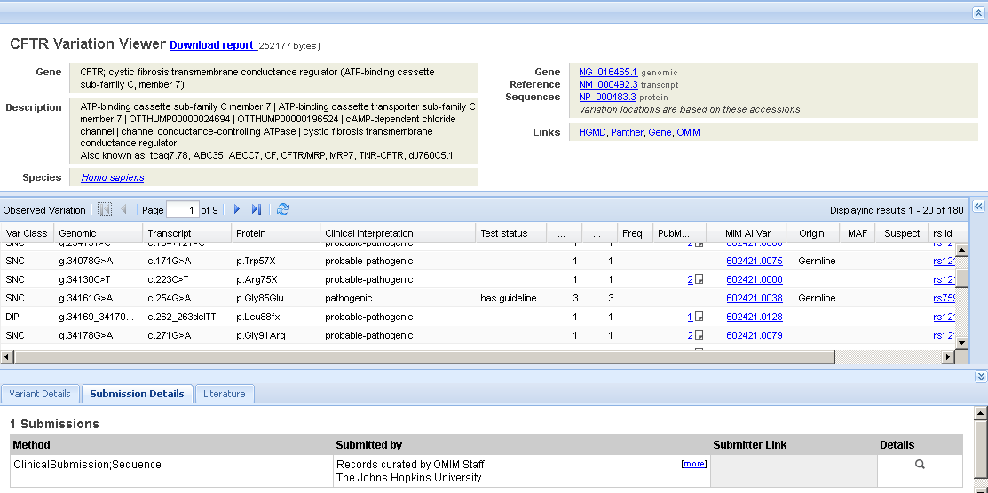
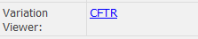
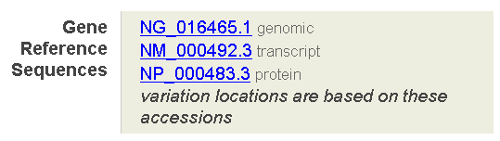
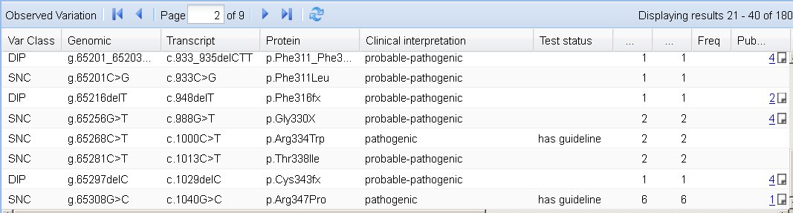
Variation Viewer http://www.ncbi.nlm.nih.gov/sites/varvu?gene=CFTR
Accessed from
Gene
dbSNP
Annotation

Slide 25
Outline
What is RefSeqGene?
How can I find a RefSeqGene sequence of interest?
How does a RefSeqGene record help me?
What tools are available?
Using RefSeqGene in a sample workflow

Slide 26
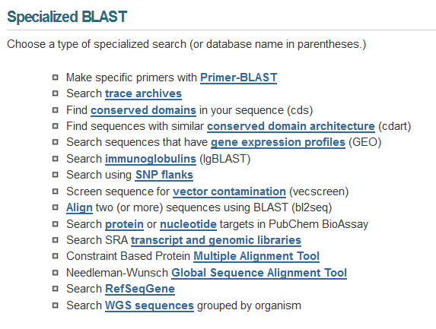
Using RefSeqGene as your standard
obtain a genomic sequence result, find the RefSeqGene standard, and compare
http://blast.ncbi.nlm.nih.gov/blast/
(Also found from RefSeqGene home page)
Scroll down

Slide 27
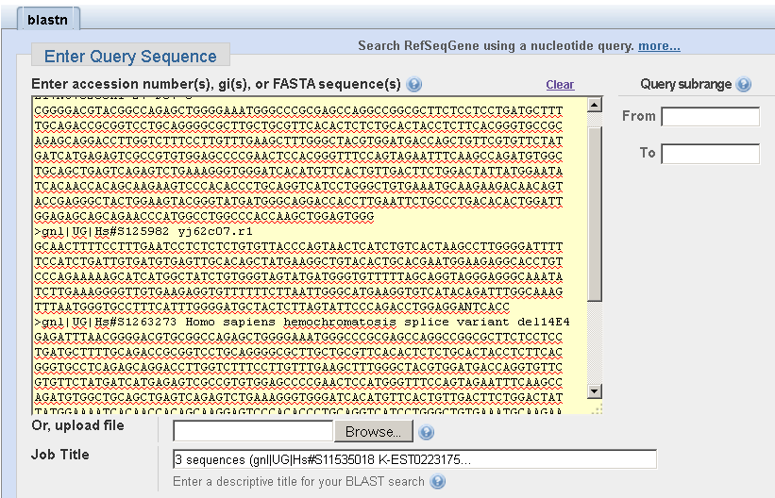
Submit obtained sequence
REMINDERS:
more than one sequence can be analyzed at a time
Each should be submitted as FASTA, starting with the > symbol

Slide 28
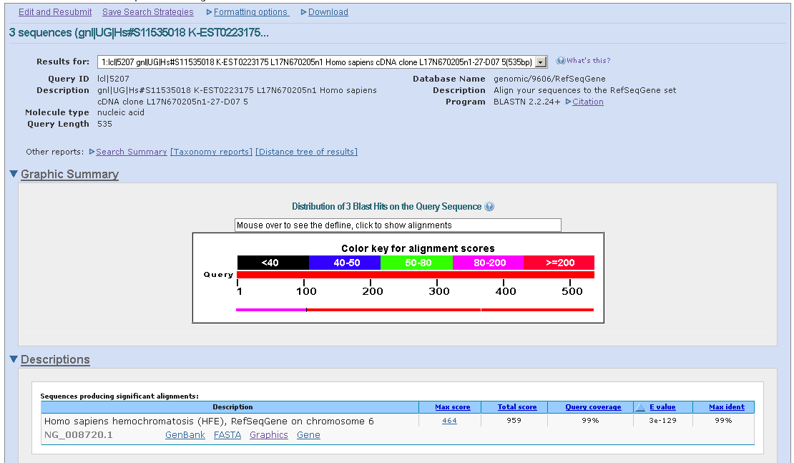
Review the RefSeqGene sequences that were matched (in this case only one)

Slide 29
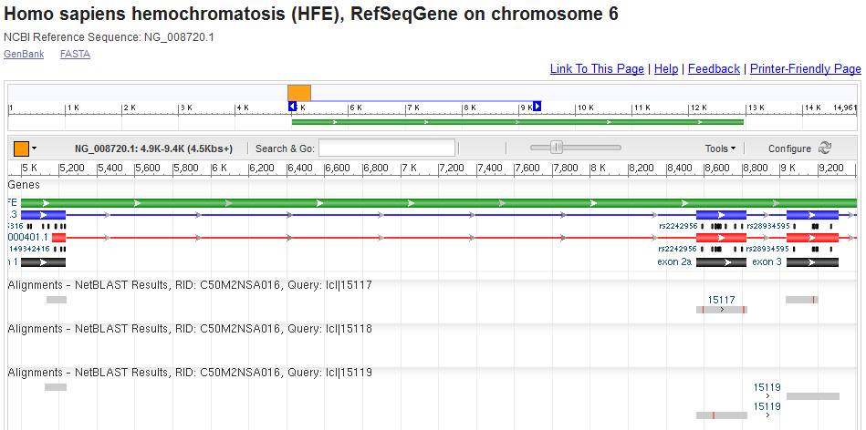
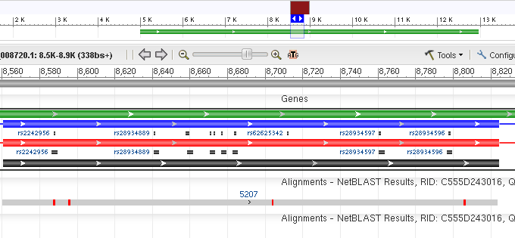
Review the alignments, and focus on areas where there are differences
The alignments are shown in grey, with mismatches marked in different colors

Slide 30
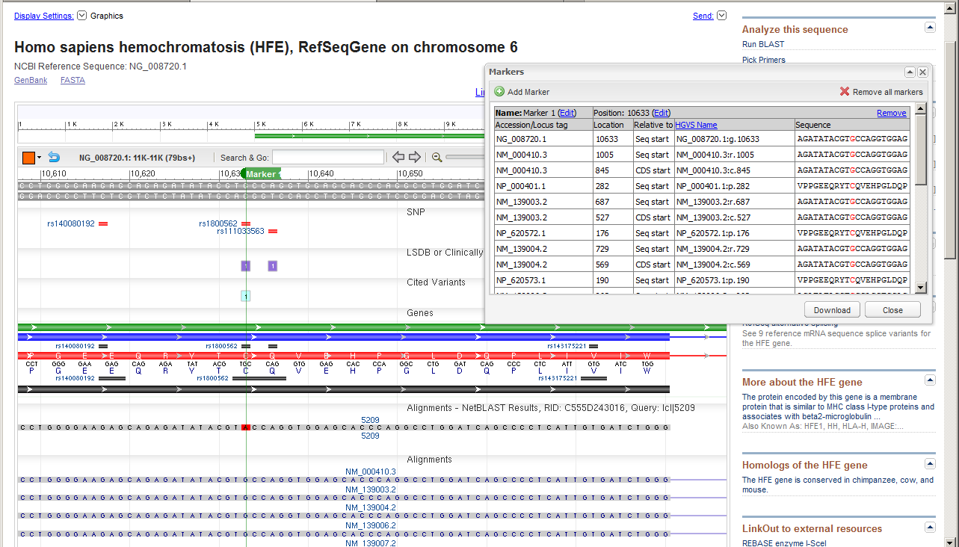
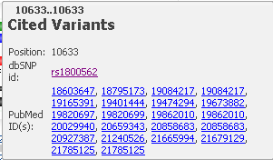
Zoom in, review, identify HGVS expression and follow links to PubMed and variation records for more details

Slide 31
Summary
RefSeqGene is a mature resource
~4500 records
Part of international collaboration with Locus Reference Genomic/LRG
Provides stable reference standard for reporting sequence variation
Tightly coupled with RefSeq mRNA and protein sequences
Used by public variation databases (dbSNP/dbVar) to report both common variation and rare variation
Used to anchor reports of publications and interpretations of clinical significance
Part of key tool set for analyzing variants a few at a time (BLAST, sequence viewer) or in large sets (Clinical Remap, Variation Reporter)

Slide 32
Acknowledgements
RefSeqGene/LRG staff
Ray Tully, Ph.D.
Alex Astashyn
Andrei Shkeda
RefSeq and CCDs curators
Staff of dbSNP/dbVar
Domain experts

Slide 33
More information
http://www.ncbi.nlm.nih.gov/refseq/rsg/
Provides links to RefSeqGene-related tools and documentation
rsgene@ncbi.nlm.nih.gov
Contact us
http://www.youtube.com/ncbinlm
Videos on use of our sequence tools and more…
http://www.ncbi.nlm.nih.gov/clinvar
Aggregating information about medically important human variation. Will be a distinct web resource later this year.
http://www.ncbi.nlm.nih.gov/gap/PheGenI
Association studies, including expression QTLs

Slide 35
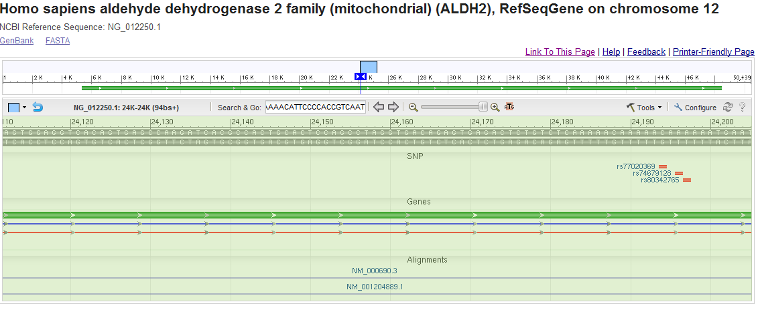
Calculating HGVS expressions open graphical display of a genomic sequence, enter a location , feature, or sequence to which you want to zoom, and press enter (Search and go)
http://www.ncbi.nlm.nih.gov/nuccore/238776813?report=graph

Slide 36
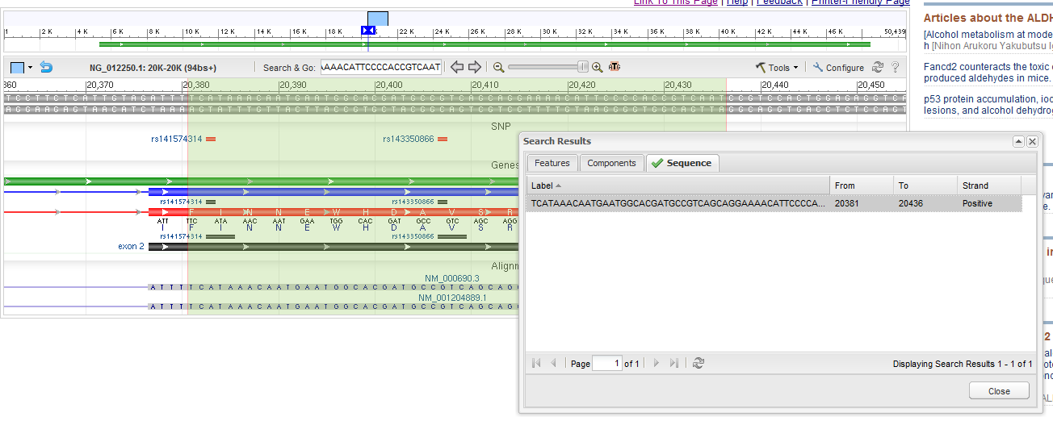
Click on the line of the report that indicates your search result, and your display will focus there

Slide 37
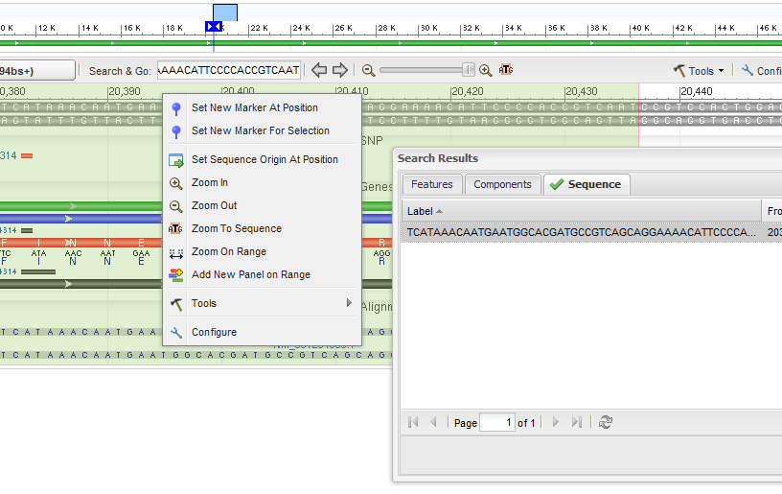
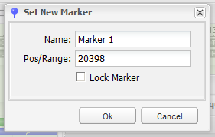
Right click on in the region of the display with the ruler, at a point of interest to you and click on Set New Marker at Position

Slide 38
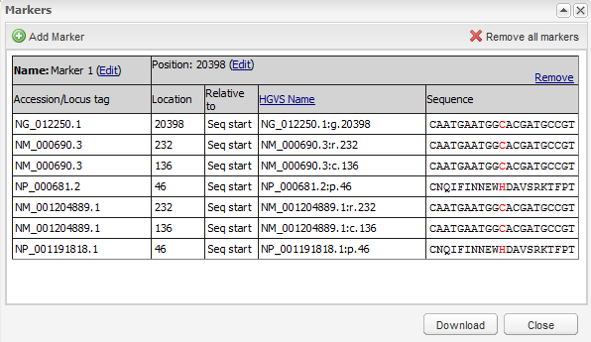
When the marker is exactly where you want it (point or range), right click and select Marker Details
A display like this will appear and allow you to read the location in mRNA coordinates (r.), from the AUG (c.) and the protein (p.)

